Slide 1

My Linear Relationships Interactive Notebook
Name
Class
Term 4 Semester 2

Slide 2
Contents
Formula Page
Page
Date
Description
2
3

Slide 3
Tasks
24
7
30
Essential Question
Questions
Notes
Summary
8
9

Slide 4
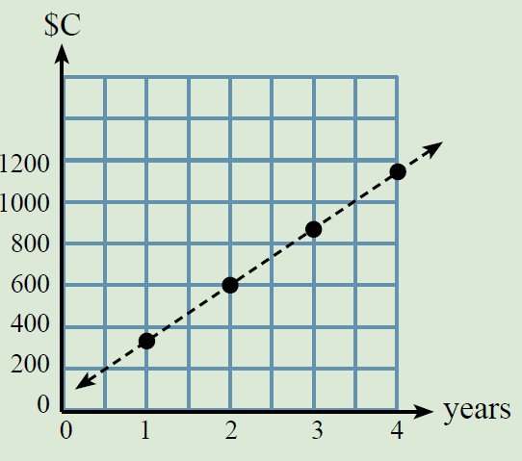
24
7
30
Date
Drawing and using Linear Graphs
EQ – How do you use a Linear Model?
I have a bank account that goes up as a linear model each year. Using the table below let’s work out a model that we can use so we will know what we started with and what we will have in 5,8,10 years time?
Year | 0 | 1 | 2 | 3 | 4
Amount in bank |  | 320 | 600 | 880 | 1160
11

Slide 5
24
7
30
Date
Drawing and using Linear Graphs
EQ – How do you use a Linear Model?
I have a bank account that goes up as a linear model each year. Using the table below let’s work out a model that we can use so we will know what we started with and what we will have in 5,8,10 years time?
To find the 0 year
320
-280
40
Year | 0 | 1 | 2 | 3 | 4
Amount in bank | 40 | 320 | 600 | 880 | 1160
Use say the year 2 and the year 1 to find out how much it goes up by each year.
600
-320
280
Each year $280 is added to the account.
Because it happens each year this is what is multiplied by the year.
C($) = 280 * yr + 40
Eg yr 3 would be
C = 280 * 3 + 40
= 840 + 40
= 880
Correct ✓
11

Slide 6
Questions Ex 16.3 and Ex 16.4 Pages 216 & 217

Slide 7
24
7
30
Date
Drawing Linear Graphs
EQ – How do you draw a graph given the equation?
11

Slide 8
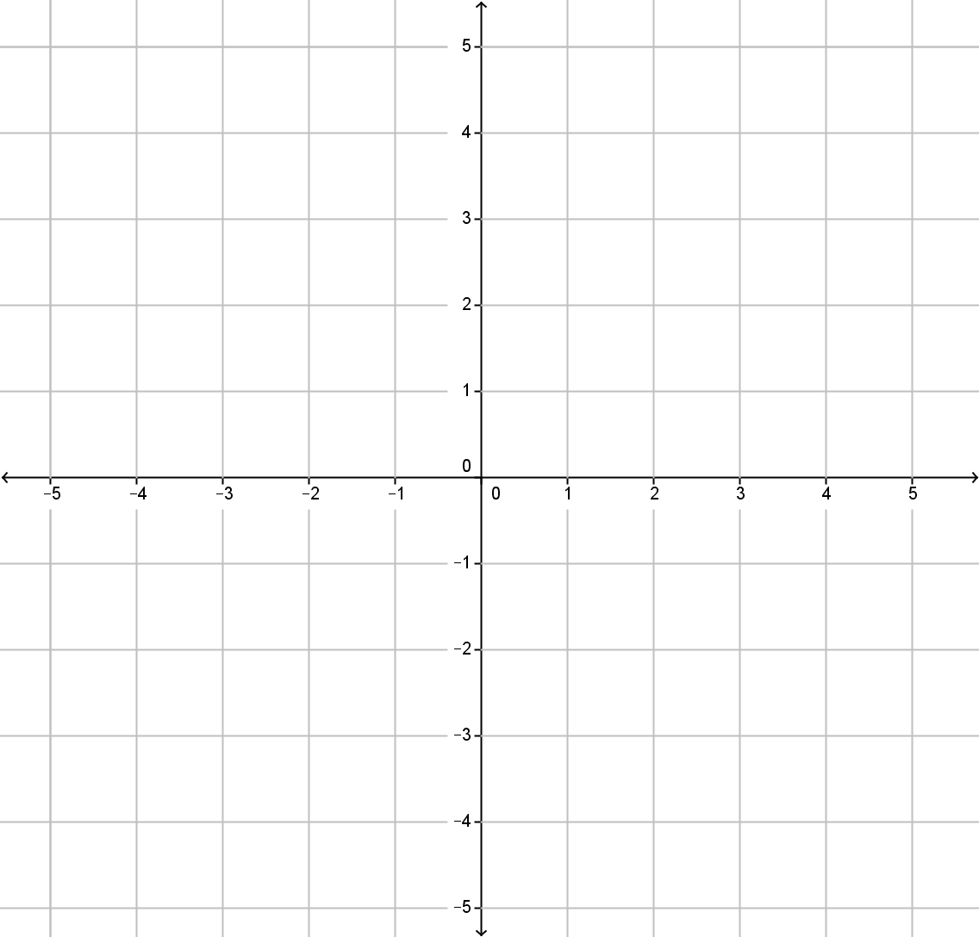


Draw a coordinate grid from -5 to 5 on both axes.
$$y$$
$$x$$

Slide 9
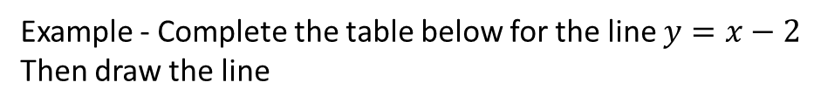
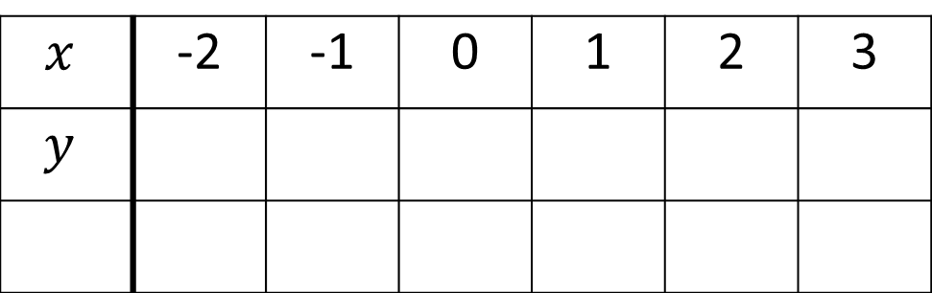

24
7
30
Date
Drawing Linear Graphs
EQ – How do you draw a graph given the equation?
Substitute the values of $x$ into the equation to find the values of $y$.
Example - Complete the table below for the line $y=x−2$
Then draw the line
$$x$$ | -2 | -1 | 0 | 1 | 2 | 3
$$y$$
9

Slide 10
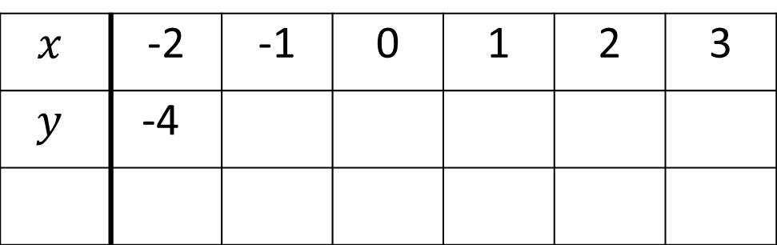
24
7
30
Date
Drawing Linear Graphs
EQ – How do you draw a graph given the equation?
Substitute the values of $x$ into the equation to find the values of $y$.
Example - Complete the table below for the line $y=x−2$
Then draw the line
$$x$$ | -2 | -1 | 0 | 1 | 2 | 3
$$y$$ | -4
9

Slide 11
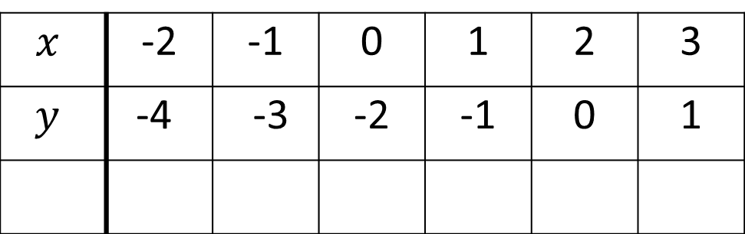
24
7
30
Date
Drawing Linear Graphs
EQ – How do you draw a graph given the equation?
Substitute the values of $x$ into the equation to find the values of $y$.
Example - Complete the table below for the line $y=x−2$
Then draw the line
$$x$$ | -2 | -1 | 0 | 1 | 2 | 3
$$y$$ | -4 | -3 | -2 | -1 | 0 | 1
9

Slide 12
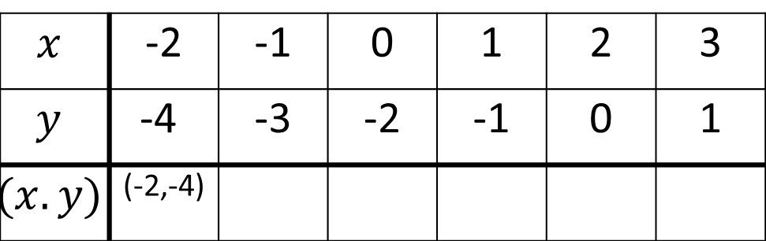
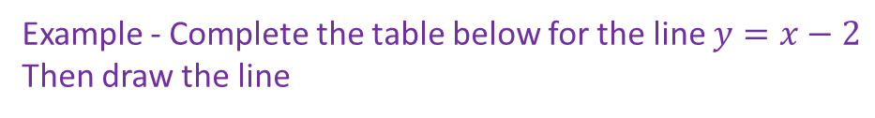
24
7
30
Date
Drawing Linear Graphs
EQ – How do you draw a graph given the equation?
Substitute the values of $x$ into the equation to find the values of $y$.
Example - Complete the table below for the line $y=x−2$
Then draw the line
$$x$$ | -2 | -1 | 0 | 1 | 2 | 3
$$y$$ | -4 | -3 | -2 | -1 | 0 | 1
$$(x.y)$$ | (-2,-4)
Plot these coordinates on a number plane
9

Slide 13
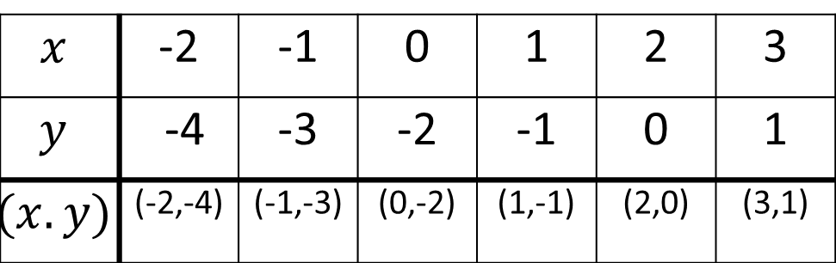
24
7
30
Date
Drawing Linear Graphs
EQ – How do you draw a graph given the equation?
Substitute the values of $x$ into the equation to find the values of $y$.
Example - Complete the table below for the line $y=x−2$
Then draw the line
$$x$$ | -2 | -1 | 0 | 1 | 2 | 3
$$y$$ | -4 | -3 | -2 | -1 | 0 | 1
$$(x.y)$$ | (-2,-4) | (-1,-3) | (0,-2) | (1,-1) | (2,0) | (3,1)
Plot these coordinates on a number plane and draw a line through the points.
Make sure you label the graph and put arrows on your lines
9

Slide 14
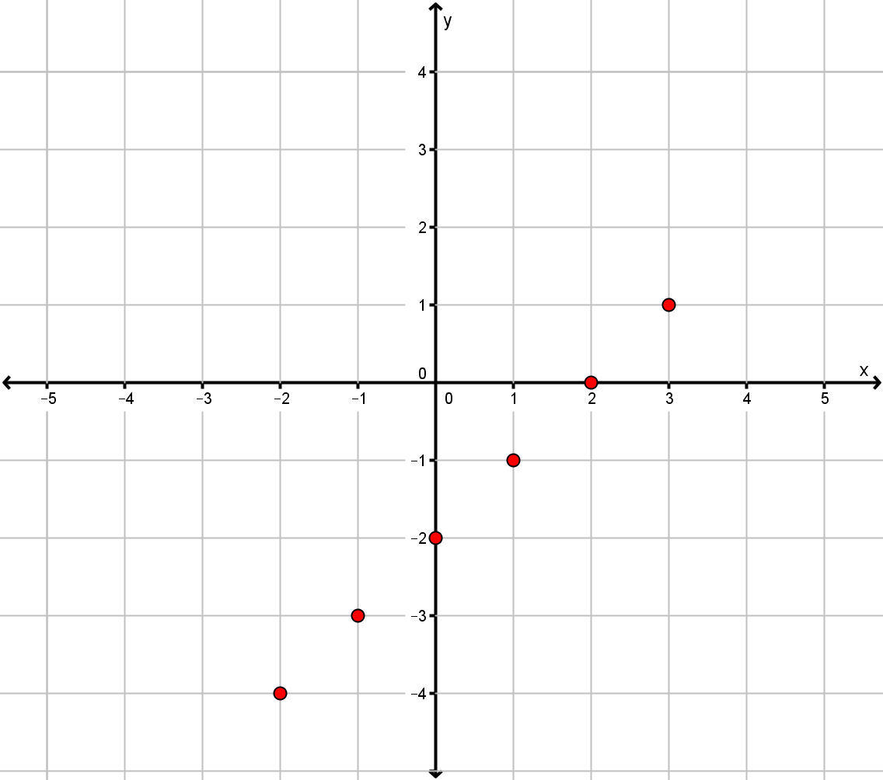

Slide 15
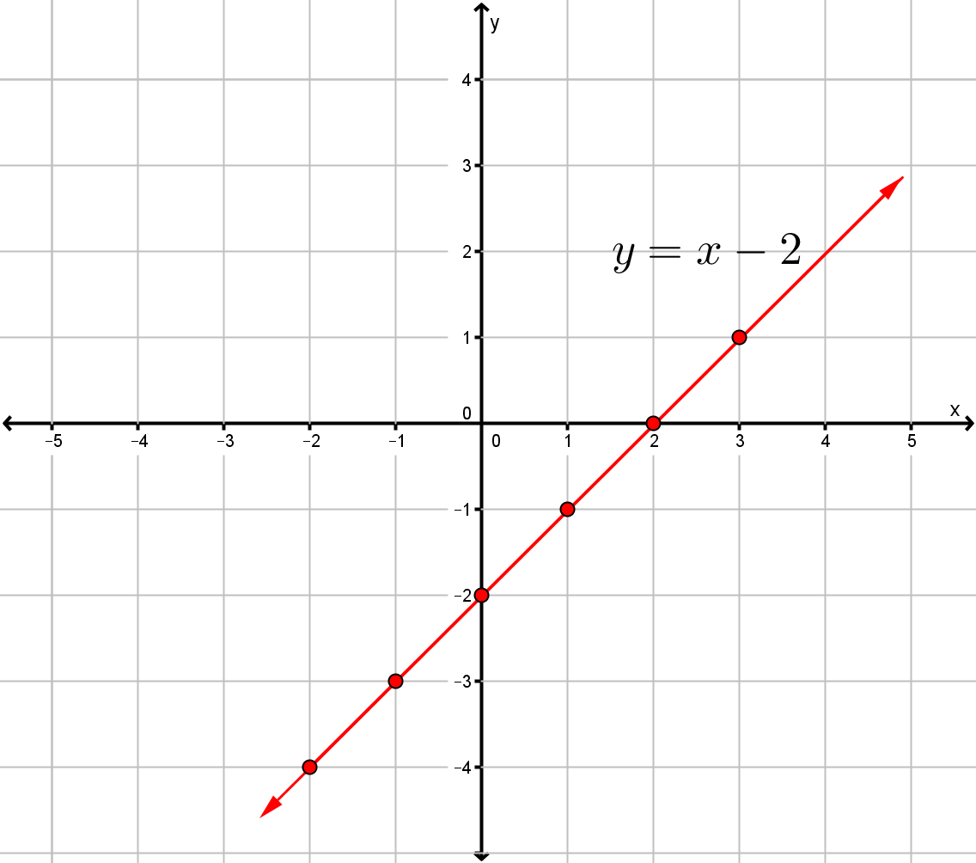

Slide 16

Task – Complete a table and draw the line for the given equation
$y=2x$
$y=x+3$
$y=2x+1$
$y=4−x$
$y=3x−4$
$y=2$

Slide 17
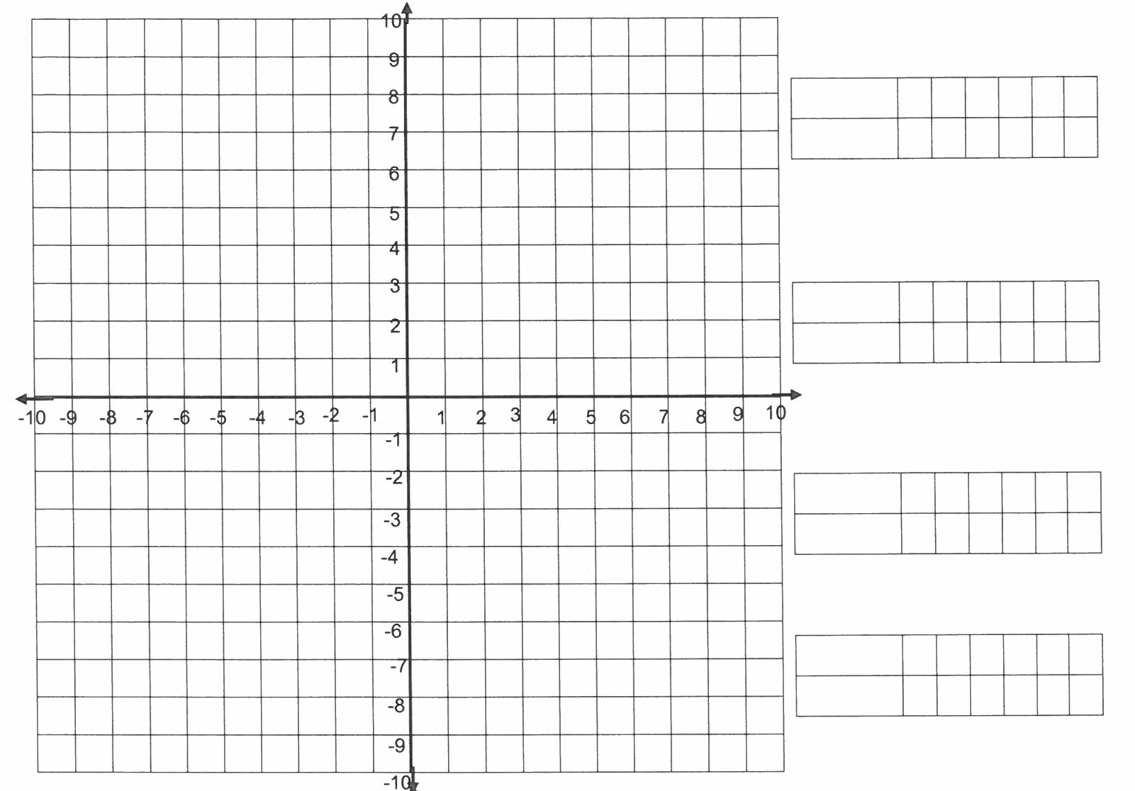

Slide 18
Questions Ex 16.5, 16.6 & 16.7 Pages 218 - 220

Slide 19
Notes Review
24, 7 ,30
Date
Title
Essential question
Notes complete
Notes complete with colour and diagrams
Questions completed
Contents page filed in
Formula page filled in

Slide 20
Homework
Review your notes and write a summary answering the essential question.

